Slide 1
Dien Bien Phu
The last gamble
Elias (Fr) vs Mats(VM)
Spring 2015
Turn 1, Scen A
Turn 7, Scen B
Turn 11, Scen C
Turn 15, Scen D

Slide 2
Notable is that no units French units escaped the fall of Gabrielle and Beatrice. This severely reduced the strength of the defence of the remaining strongpoints.
Turn 1 – Mar 13-15
165
312
57
304
(176)
316
209
312
98
316
(176)
316
174
316
141
312
9
304
(176)
316
148
102
308
36
308
88
308

Slide 3
With H1 fully Shaken, no reinforcements could reach the assaulted strongpoints – all single company hexes.
Turn 2 – Mar 16-18
165
57
304
(176)
316
312
98
316
(176)
316
9
304
209
312
141
312
(176)
316
148
36
102
308
308
88
308
174-
(174)
316
316
174
316

Slide 4
VM regroups and the French fails to dislodge the foothold at H6.
Turn 3 – Mar 19-21
165
57
304
(176)
316
312
98
316
(176)
316
209
312
141
312
9
304
(176)
316
148
102
308
(174)
316
88
308
174-
316
36
308

Slide 5
The staunch paratroopers and legioneers at Francoise repel the attackers, eventhough the supporting strongpoints can’t reinforce as they are Shaken or threatened themselves.
Turn 4 – Mar 22-24
165
57
304
(176)
316
312
98
316
(176)
316
209
312
141
312
9
304
(176)
316
148
102
308
(174)
316
174
316
174-
316
88
308
36
308

Slide 6
Realizing that in just a few turns, the rain will make reinforcing in the 308 sector so much harder, focus is shiftet to 312 sector.
A fierce battle over D2 and D5 will last for over a week.
Turn 5 – Mar 25-27
165
57
304
(176)
316
312
98
316
(176)
316
141
312
9
304
(176)
316
148
174
102
308
174-
(174)
316
316
316
88
308
36
308
209
312

Slide 7
The VM seems to get the upper hand…
Turn 6 – Mar 28-30
57
304
(176)
316
(176)
316
9
304
165
141
312
312
174
316
98
316
(176)
316
148
Status end of turn 6
VM 65 repl, 5 ammo,
Reduced batt 10 (2 cadre)
Elim batt 1
5 morale all div, 45 strongpoint
FR: Dead 7 inf comp, 1 art
Wounded 8 inf comp
Reduced 11 inf comp
3 batt released by Hanoi
Med 9, Ammo 23, Food 8,
Fuel 10, Trucks 5
102
308
88
308
36
308
209
312

Slide 8
But the French retakes D5.
Turn 7 – Mar 29-Apr 2
57
304
(176)
316
9
304
(176)
98
316
316
141
174
316
165
312
312
(176)
316
148
102
308
88
308
36
308
209
312

Slide 9
With D5 firmly held by two para companies, the thinly held D1 bravely repels the attackers.
With the rain, attacks in 308 sector are renewed.
Turn 8 – Apr 3-5
57
304
(176)
316
9
304
(176)
316
141
312
174
165
316
(165)
312
312
98
316
(176)
316
148
Status end of turn 8
VM 55 repl, 5 ammo,
Reduced batt (3 cadre)
Elim batt 0
5 morale all div, 44 strongpoint
FR: Dead 7 inf comp, 1 art
Wounded 8 inf comp
Reduced 16 inf comp
3 batt released by Hanoi
Med 8, Ammo 17, Food 7,
Fuel 8, Trucks 4
102
308
88
308
36
308
209
312

Slide 10
As the trenches cathes up, D1 is surrounded, giving the VM a well earned rest.
The French relief attempts fail.
Turn 9 – Apr 6-8
57
304
(176)
316
9
304
141
312
165
312
174
(176)
316
316
(165)
312
98
316
(176)
316
148
102
308
88
308
209
312
36
308

Slide 11
The plan for VM is to be within striking distance of the central area before the monsoon comes.
As the defence thickens, the surround tactics will be increasingly important.
Turn 10 – Apr 9-11
57
304
(176)
316
9
304
(165)
312
141
312
165
312
174
316
(176)
316
98
316
(176)
316
148
Status end of turn 10 (Start C)
VM 50 repl, 5 ammo, (50, 16)
Reduced batt 18 (3 cadre) (2, (2 cadre))
Elim batt 0
5 morale all div, (5-312, 314; 4-308, 316)
40 strongpoint (42)
FR: Gone 12 inf comp, 1 art (10,3)
Wounded 11 inf comp (15)
Reduced 12 inf comp (26)
4 batt released by Hanoi (4)
Med 22, Ammo 17, Food 5,
Fuel 7, Trucks 4 (10, 18, 4, 5, 3)
102
308
88
308
209
312
36
308

Slide 12
As all divisions but the 304th are very worn down, active fighting is shifted to Isabelle.
Turn 11 – Apr 12-14
(176)
316
57
304
9
304
(165)
312
141
312
(176)
316
174
316
98
316
(176)
316
148
102-
Status end of turn 10 (Start C)
VM 50 repl, 5 ammo, (50, 16)
Reduced batt 18 (3 cadre) (2, (2 cadre))
Elim batt 0
5 morale all div, (5-312, 314; 4-308, 316)
40 strongpoint (42)
FR: Gone 12 inf comp, 1 art (10,3)
Wounded 11 inf comp (15)
Reduced 12 inf comp (26)
4 batt released by Hanoi (4)
Med 22, Ammo 17, Food 5,
Fuel 7, Trucks 4 (10, 18, 4, 5, 3)
102
308
308
165
(102)
308
312
88
308
36
36-
(36)
308
308
308
209
312

Slide 13
A pause in hostilities as VM regroups.
Turn 12 – Apr 15-17
(176)
316
9
304
(165)
312
(102)
308
141
312
57
304
(176)
316
174
316
(176)
316
148
Status end of turn 12
VM 43 repl, 4 ammo
Reduced batt 20 (3 cadre)
Elim batt 0
5 morale all div
37strongpoint (and 5 more to pick at Isabelle)
FR: Gone 25 inf comp, 3 art 1 tank
Wounded 10 inf comp
Reduced 20 inf comp
4 batt released by Hanoi
Med 14, Ammo 9, Food 9,
Fuel 4, Trucks 2
88
308
165
312
102-
308
98
316
(36)
308
36
308
209
312
36-
308

Slide 14
Isabelle falls rapidly as the VM barrage is very effective, and the desperate last counterattack fails.
Turn 13 – Apr 18-20
(176)
316
9
304
(165)
312
(102)
308
141
312
57
304
(176)
316
174
316
(176)
316
148
165
312
88
308
98
316
102-
308
36
308
209
312

Slide 15
Last turn before the monsoon. The central area is within reach.
Turn 14 – Apr 21-23
(176)
316
9
304
(165)
312
(102)
308
141
312
(176)
316
57
304
174
316
(176)
316
148
Status end of turn 14 (Start D)
VM 50 repl, 5 ammo, (41, 18)
Reduced batt 16 (1 cadre) (1, (0 cadre))
Elim batt 0
5 morale all div, (5-312, 314; 4-308, 316)
33 strongpoint (38) (and 3 more to pick at Isabelle)
FR: Gone 27 inf comp, 3 art, 1 tank (12,3)
Wounded 10 inf comp (18)
Reduced 21 inf comp (32)
4 batt released by Hanoi (4)
Med 24, Ammo 8, Food 7,
Fuel 7, Trucks 1 (10, 18, 4, 3, 1)
165
312
88
308
98
316
102
102-
308
308
36
308
209
312

Slide 16
With the French ammo very low, VM ventures out in the open threatens the supply area from three direction.
Turn 15 – Apr 24-26
(176)
316
9
304
141
312
57
(176)
316
304
174
316
(176)
316
148
Status end of turn 14 (Start D)
VM 50 repl, 5 ammo, (41, 18)
Reduced batt 16 (1 cadre) (1, (0 cadre))
Elim batt 0
5 morale all div, (5-312, 314; 4-308, 316)
33 strongpoint (38) (and 3 more to pick at Isabelle)
FR: Gone 27 inf comp, 3 art, 1 tank (12,3)
Wounded 10 inf comp (18)
Reduced 21 inf comp (32)
4 batt released by Hanoi (4)
Med 24, Ammo 8, Food 7,
Fuel 7, Trucks 1 (10, 18, 4, 3, 1)
(165)
88
165
312
312
308
98
(102)
102
102-
316
308
308
308
209
312
36
308

Slide 17

Despite a mainly ineffective barrage, a few strong points falls in the central area. This severely reduces the French ability to react with reinforcements to coming attacks.
Turn 16 – Apr 27-29
(176)
316
(102)
9
308
304
141
312
36-
57
(36)
308
304
(176)
316
308
174
316
174-
(174)
316
316
(176)
316
148
165-
312
(9)
304
(9)
304
(165)
88
(9)
312
308
98
304
102-
308
316
209
312
36
308
For the final stage, French stacks are shown.
Single Inf comp
Single Art
Multiple units

Slide 18
VM tries to isolate the outer strongpoint but French LoC is established.
The Laos relief force is released.
Barring supply friktion, no supply is needed to be flown in.
Turn 17 – Apr 30-May 2
(176)
316
(102)
308
(141)
141-
141
312
312
312
(176)
316
57
(36)
308
304
(174)
36-
308
316
174-
316
(176)
316
148
165-
(165)
(165)
312
312
312
88
(9)
304
308
(9)
304
(165)
312
98
316
(102)
(9)
(102)
308
304
308
(209)
209-
209
312
312
312
For the final stage, French stacks are shown.
Single Inf comp
Single Art
Multiple units

Slide 19
The second major attack is a major failure, with five of nine with No effect.
Still the fall of Epervier gives a surrender roll vs 10. And a 12 is rolled, the French surrenders!
Turn 18 – May 3-5
(57)
(176)
304
316
(102)
308
(165)
312
(176)
(57)
(57)
316
57
304
304
141-
(36)
304
141-
141-
312
308
312
312
(141)
312
(174)
36-
308
316
174-
316
(9)
(176)
(165)
312
304
316
148
88
308
(9)
(102)
308
304
209-
312
(102)
98
316
(9)
(102)
308
304
308
(209)
312
(165)
312
For the final stage, French stacks are shown.
Single Inf comp
Single Art
Multiple units

Slide 20
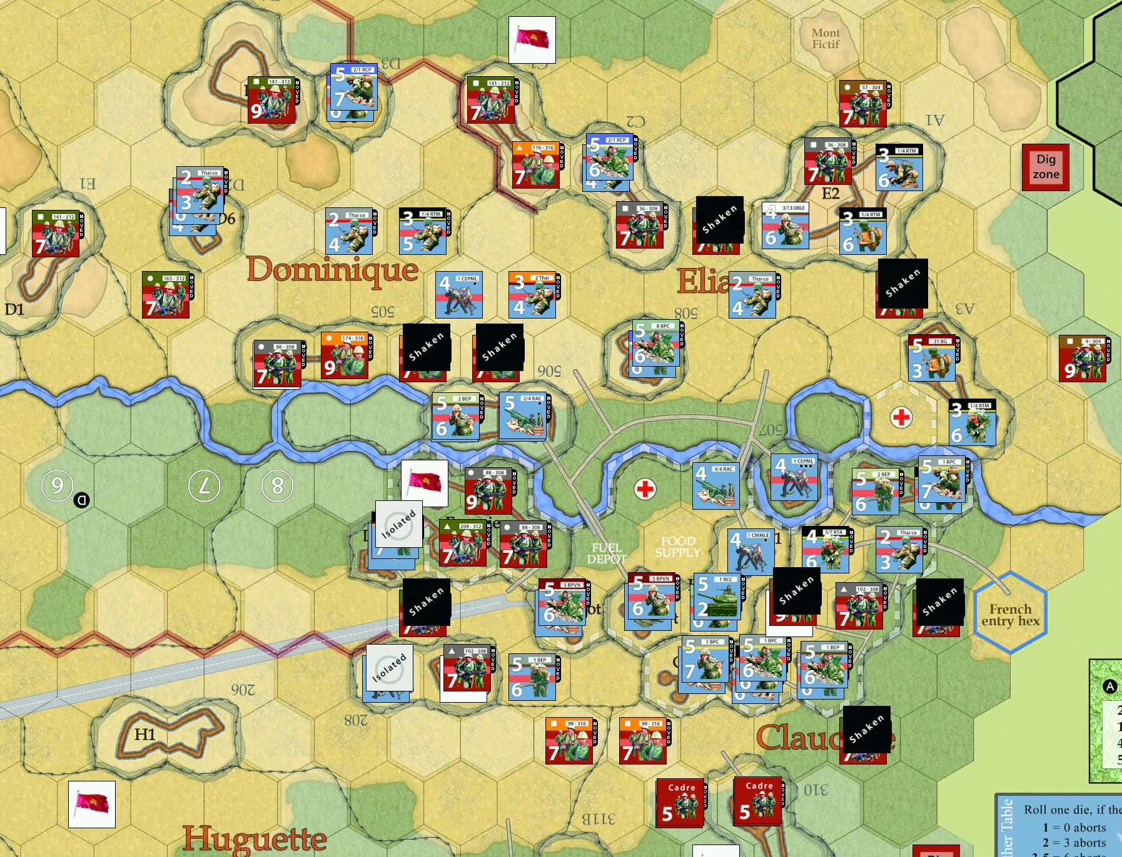
Situation at the end of the game

